Slide 1






Smart water tank Monitoring System
IOT BASED PROJECT
Nitesh kumar
Yash jha

Slide 2

Smart Water Tank Monitoring System
Introduction
Water is one of the most essential resources for daily life, and its efficient management is crucial to prevent wastage. With increasing demand for water in residential, commercial, and agricultural sectors, ensuring its proper utilization has become a priority. However, traditional water tank systems rely on manual monitoring, leading to various challenges, such as overflow, shortages, and inefficient usage. These conventional methods often require human intervention, making them time-consuming, unreliable, and prone to human error. Such inefficiencies result in excessive water wastage, increased electricity consumption, and user inconvenience.

Slide 3

Data Collection
Water Level Data – Measures the current water level inside the tank.
Pump Status Data – Indicates whether the water pump is ON or OFF.
Flow Rate Data – Tracks the rate at which water is being filled or consumed.
Temperature and Humidity Data (optional) – Helps monitor environmental factors that may affect water quality.
Time-stamped Usage Data – Records when water is used, aiding in consumption analysis.
Alert and Notification Logs – Stores alerts sent to users regarding water level status.

Slide 4

Data Collection Methods
· Sensor-based data Collection
Ultrasonic sensors continuously monitor water levels and send data to the microcontroller.
Float sensors detect when the water reaches a certain level and trigger actions accordingly.
Flow sensors measure water usage and detect leakages.
· Automated Data Logging
The microcontroller processes sensor data and logs it to a cloud-based platform for real-time monitoring.
Time-stamped data helps in analyzing daily, weekly, or monthly water consumption patterns.
· Wireless Data Transmission
Data is transmitted using Wi-Fi or GSM modules to cloud platforms like Thing Speak, Firebase, or Blynk for remote access.
Users receive notifications and alerts on their smartphones or web dashboards.

Slide 5
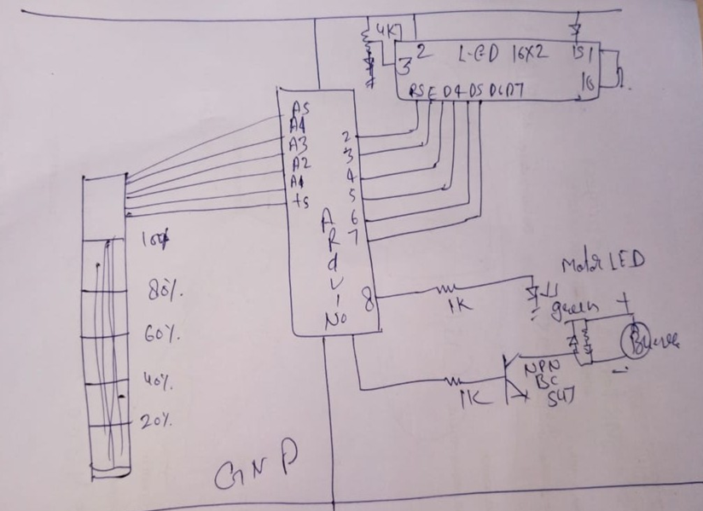
Circuit Diagram
The circuit diagram represents a water level monitoring system that uses a combination of a microcontroller (or decoder IC), sensors, an LCD, and an alert system. Below is a detailed analysis of the different sections of the circuit.

Slide 6
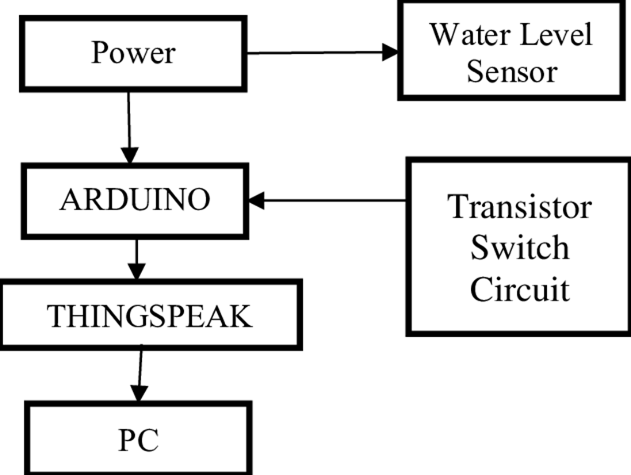
Block Diagram

Slide 7
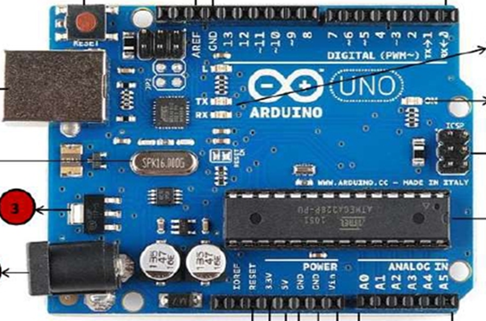
Arduino (Microcontroller)

Slide 8

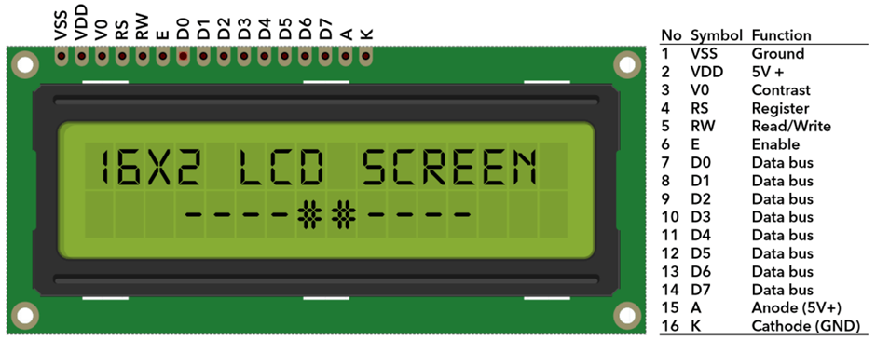
16x2 LCD Display
A 16x2 LCD (Liquid Crystal Display) can display 16 characters per line and has 2 lines. It is commonly used in embedded systems to show output data.

Slide 9

The Challenges of Smart water tank Monitoring System

Slide 10


Smart water tank Monitoring System challenge
Sensor Accuracy & Reliability
Water level sensors (ultrasonic, float, capacitive) can give inaccurate readings due to dirt, temperature variations, or sensor drift.
Sensor calibration and maintenance are essential.
Data Accuracy & Processing
Real-time data transmission and storage can be affected by network latency.
Data analytics need to filter out false readings due to turbulence or sudden water level changes.
3. Power Management
Many smart water tanks are deployed in remote areas, requiring battery or solar power solutions.
Efficient power management for sensors and controllers is necessary.

Slide 11

Benefits
1. Water Conservation 💧
Prevents water wastage by monitoring usage and detecting leaks.
Ensures optimal water levels, reducing overflow and shortages.
2. Real-time Monitoring & Control 📊
Provides real-time water level updates via mobile apps or web dashboards.
Allows remote control of pumps and valves, saving manual effort.
3. Cost Savings 💰
Reduces electricity bills by optimizing pump operation.
Prevents unnecessary water purchases or tanker costs in case of shortages.
4. Automated Operations ⚙️
Automatically switches pumps ON/OFF based on water level.
Minimizes the need for manual checking and control.
5. Leak & Overflow Detection 🚨
Detects leaks early, preventing water loss and damage.
Sends alerts if the water level is too high or too low.

Slide 12
6. Energy Efficiency ⚡
Smart scheduling of pumps reduces energy consumption.
Solar-powered options enhance sustainability.
7. Integration with IoT & Smart Homes 🏠
Can be linked with home automation systems (Alexa, Google Home).
Supports integration with weather data for intelligent water usage.
8. Scalability for Large Systems 🏢
Useful for residential buildings, industries, and agricultural irrigation.
Cloud-based monitoring allows managing multiple tanks from one platform.
9. Enhanced Water Quality 🏞️
Smart filtration and alerts ensure clean water availability.
Detects contamination risks in storage tanks.
10. Environmental Benefits 🌍
Promotes sustainable water management.
Reduces dependence on groundwater and external water sources.

Slide 13
USED
1. Residential Buildings & Apartments 🏠
2. Industries & Factories 🏭
3. Agriculture & Irrigation 🚜
4. Commercial Buildings & Hotels 🏢
5. Municipal Water Supply & Smart Cities 🌇
6. Remote & Rural Areas 🏕️
7. Schools, Hospitals, & Public Buildings 🏫🏥

Slide 14
THANKYOU

